Slide 1

Phishing Attacks: Recognition & Prevention
Phishing is a cyberattack technique used to trick individuals. It aims to steal passwords or credit card numbers. Attackers impersonate trusted entities to manipulate victims.

Slide 2
What is Phishing? Understanding the Threat Landscape
Deceptive Tactics
Financial Gain
Wide Scope
Phishing employs deceptive emails and websites. They mimic trusted sources to steal data.
Attackers seek financial information like bank details. This can lead to identity theft or fraud.
Phishing attacks can target anyone online. Education is key to recognizing threats.

Slide 3

Common Phishing Techniques: Spot the Red Flags
1
Urgent Requests
2
Suspicious Links
Be wary of emails demanding immediate action. This is a classic phishing tactic.
Avoid clicking on links in unsolicited emails. Check the URL before clicking.
3
Poor Grammar
Many phishing emails contain grammatical errors. This is often a sign of fraud.

Slide 4
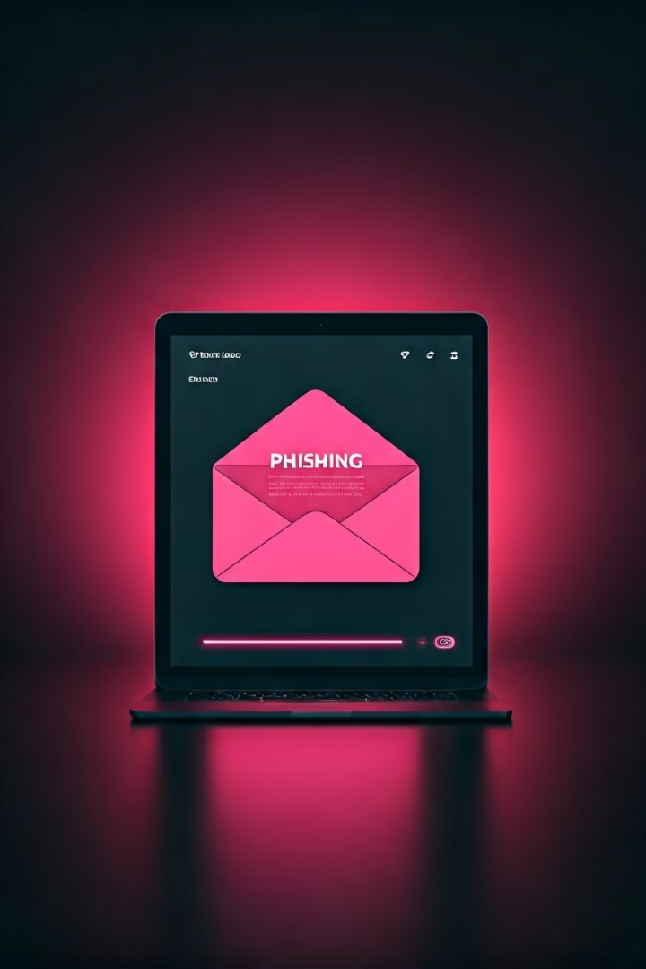



Email Phishing: Anatomy of a Deceptive Message
Sender Address
Check the sender's email address carefully. Look for subtle variations or typos.
Salutation
Generic greetings like "Dear Customer" are red flags. Legitimate emails use your name.
Call to Action
Phishing emails often include a link. They want you to click and enter information.

Slide 5




Spear Phishing & Whaling: Targeted Attacks
Spear Phishing
Whaling
Higher Stakes
Focuses on high-profile executives and leaders.
These attacks have more access and cause greater damage.
Targets specific individuals with tailored messages.

Slide 6
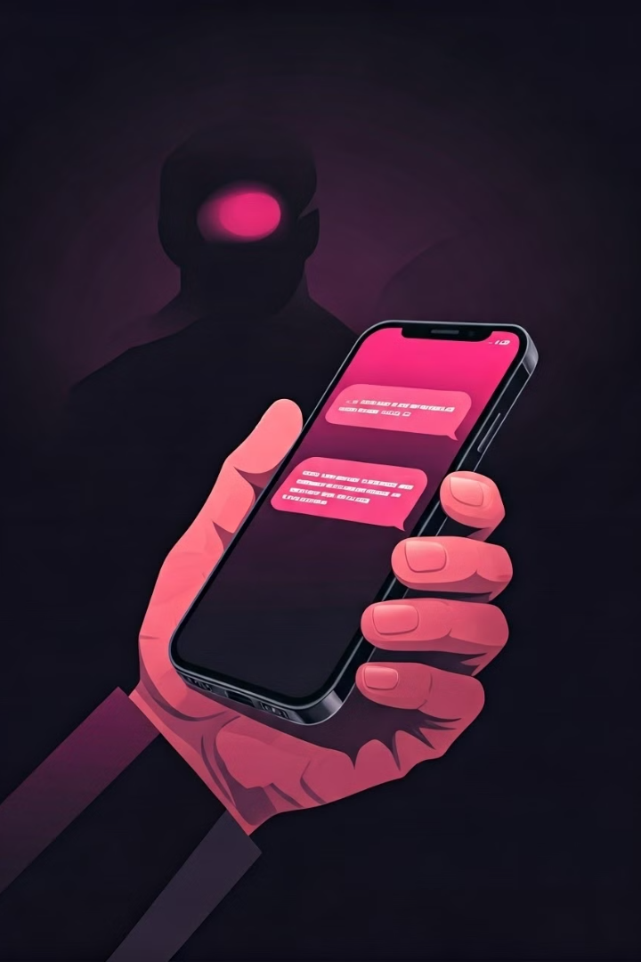
Smishing & Vishing: Phishing via SMS and Voice
Smishing
Vishing
Phishing attacks conducted through SMS text messages. Be wary of unknown numbers.
Phishing attacks carried out over the phone using voice calls. Verify the caller's identity.
Immediate Response
Smishing and Vishing create a sense of urgency, pressuring victims to act fast.

Slide 7



Website Phishing: Identifying Fake Websites
2
HTTPS
1
URL Check
Design
3
Verify the website's URL and check if HTTPS is enabled. Look for odd design choices. These steps can safeguard you from website phishing attacks.

Slide 8

Protecting Yourself: Best Practices for Individuals
1
Strong Passwords
Use unique, complex passwords. Change them regularly to maintain security.
2
Two-Factor Authentication
Enable 2FA for added security. It requires a second verification method.
3
Verify Requests
Contact the organization directly to verify any unusual requests. Don't reply to the email.

Slide 9



Organizational Security: Implementing Phishing Prevention Strategies
1
Employee training
2
Phishing simulations
3
Reporting Mechanisms
Organizations should train employees to spot phishing. Regular simulations help to prevent attacks. Implement reporting systems to address threats fast.

Slide 10


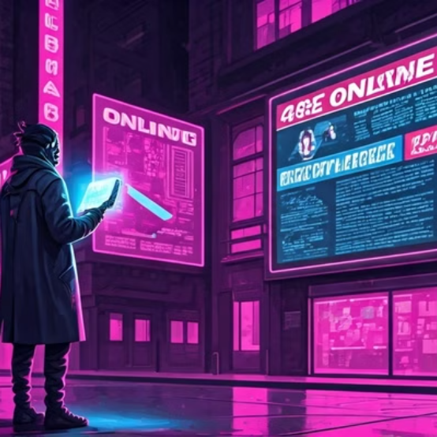
Staying Vigilant: Continuous Learning & Reporting
Cyber threats evolve daily. Stay updated on phishing techniques. Report suspicious emails and help protect others.

